Slide 1

Barat Ali Sakhizada Data Analyst
King County, WA
Analyzing real estate situation
Portfolio Case Study

Slide 2
King County, Real Estate
Overview
King County is located in the U.S. state of Washington. Its population was 2,269,675 in the 2020, making it the most populous county in Washington, and the 12th-most populous in the United States.
Data
The dataset used for this project is publicly available on Kaggle and contains house sale prices for King County, in Washington State of the USA.
Link to the Dataset: https://www.kaggle.com/datasets/harlfoxem/housesalesprediction/data
Project Objective
The primary objective of this project is to analyse factors that influence real estate prices and build predictive models that estimate house prices based on various property features. By understanding these factors, the project aims to provide insights that could benefit potential home buyers, real estate professionals, and investors in making informed decisions about property investments.
Specifically, the project will focus on identifying key drivers of property prices, exploring patterns and trends in house sales, and using predictive model techniques to predict house prices based on historical data.
Potential home buyers: Providing insights into factors that affect property value, helping them make informed purchasing decisions.
Real estate professionals: Equipping agents and brokers with data-driven insights to better price homes and advise clients.
Investors: Helping investors identify high-return properties by understanding key drivers of house prices.

Slide 3
Questions to be answered
What factors most significantly impact price of a property?
Which variables (e.g., square footage, number of bedrooms, year built, etc.) have the highest correlation with property prices?
Can we build an accurate predictive model for estimating house prices?
Which machine learning algorithms (e.g., Linear Regression, Decision Trees, Random Forest, etc.) perform best in predicting house prices?
Do properties with recent renovations have higher price tags?

Slide 4
Tools and Techniques
Tools: Python (for data analysis and modelling), Tableau (for visualization)
Techniques Applied
Data Cleaning and Processing
Exploratory Data Analysis (EDA)
Data Wrangling and Consistency Checks
Predictive modelling using Linear Regression and Clustering techniques
K-Means Clustering and Hierarchical Clustering

Slide 5
Role and Responsibilities
I acted as the lead data analyst, responsible for:
Data Cleaning and Preprocessing: Ensuring the dataset was free from inconsistencies and missing values that could skew analysis.
Data Wrangling and Consistency Checks
Exploratory Data Analysis (EDA): Identifying patterns and relationships in the data.
Predictive Modelling: Building and evaluating regression models to estimate house prices.
K-Means Clustering
Visualization and Communication: Using Tableau to create dashboards and visual representations of findings.

Slide 6
Challenges | Solutions
The data is from 2014-2015 which means that insights from an analysis on this data may not reflect current housing price trends. | Emphasized more on aspects of analysis that remain relevant overtime even without receiving fresh data, such as the relationship between house price and house size.
Missing values in features like yr_renovated could skew analysis. | Used median imputation for missing values and removed features with excessive missing data.
Linear regression alone explained only 49.3% of price variability. | There are other factors such as proximity to facilities, neighborhood quality, local economy, macro economy situation and etc, however, the data on these factors were non-available. I clearly mentioned this as a limitation to this study.
Clusters lacked clear separation in some cases. | Adjusted the number of clusters using the elbow method and tested hierarchical clustering.

Slide 7
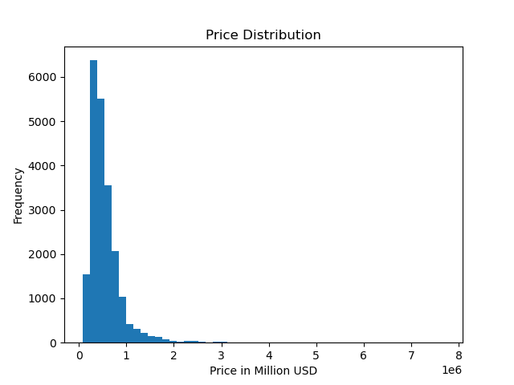
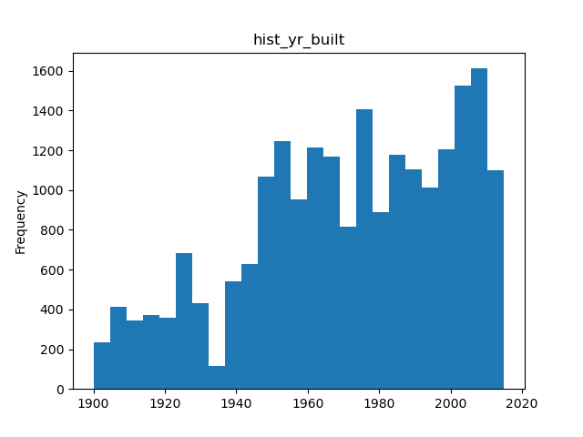
Majority of the house prices fall between 0 - 1 million. A percentage of houses cost between 1 - 2 million and only a small number of houses cost more than 2 million USD.
Analysis
Majority of the houses have been built between 1950 and 2017. The number of houses built after 2000 is higher than the number of houses built before, however, the difference is not significant.

Slide 8
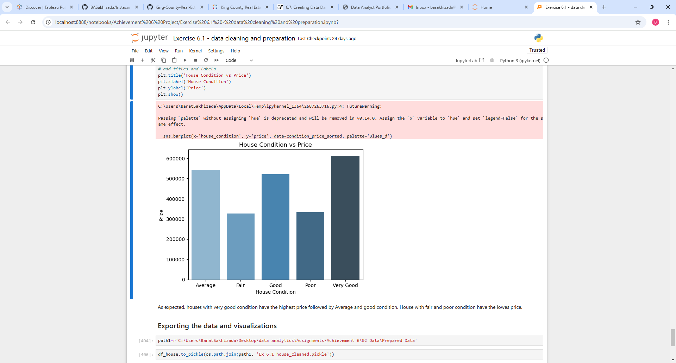
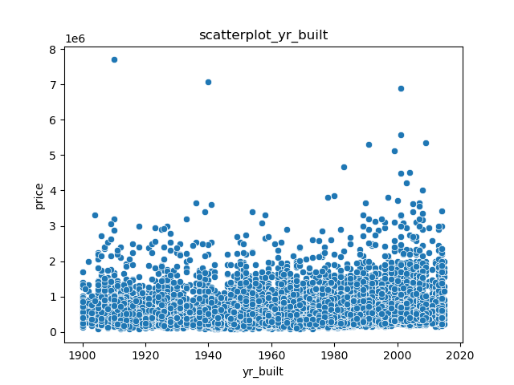
Analysis
There's no strong upward or downward trend between the year built and price. While we might expect newer homes to be more expensive, the prices appear fairly dispersed across all years, suggesting other factors are influencing price more strongly. There seems to be a slight increase in the upper range of house prices for houses built after 1980 or 2000, but it's not a very strong pattern.
As expected, houses with very good condition have the highest price followed by Average and good condition. House with fair and poor condition have the lower price.

Slide 9
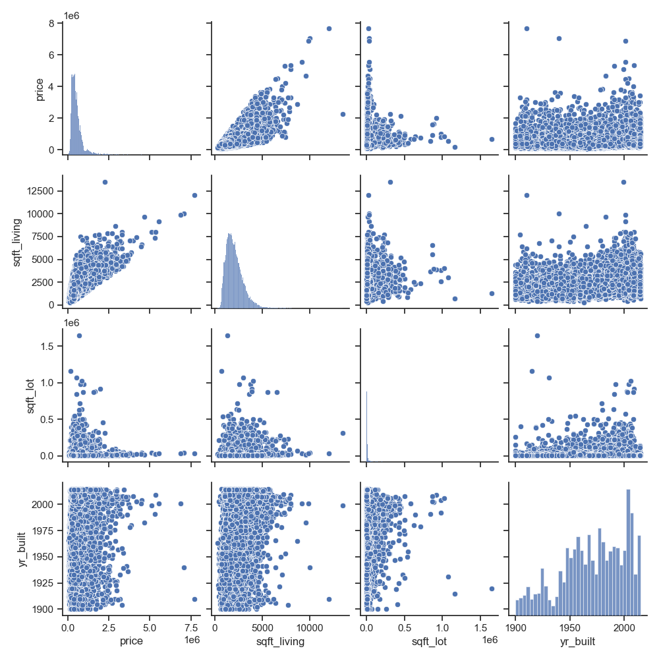
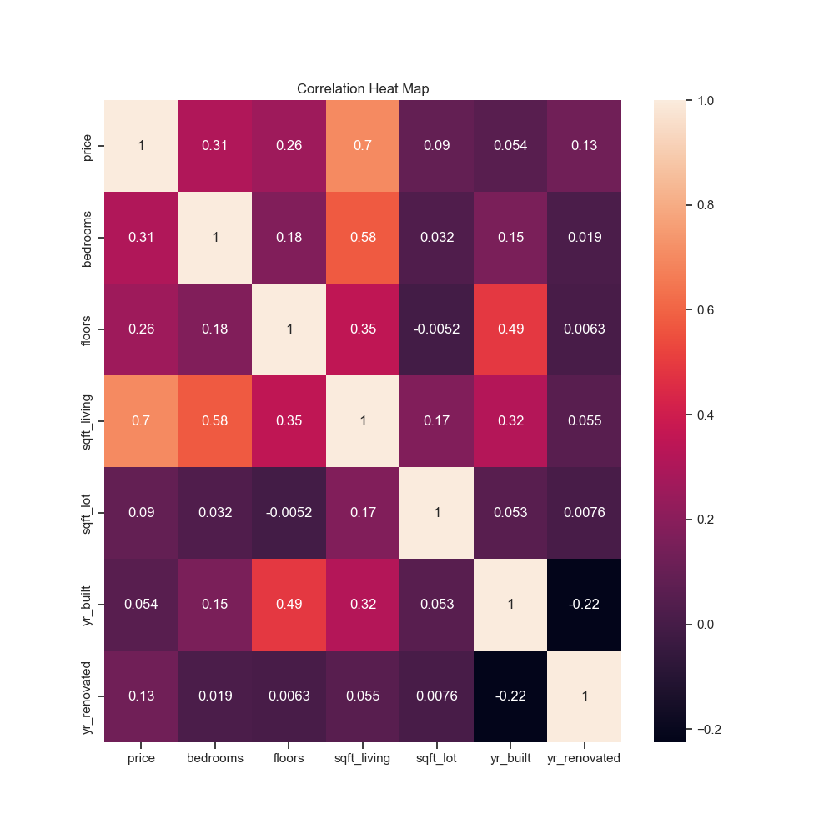
- sqft_living (total square footage of the interior living space) is the most influential factor on house price, with a strong positive correlation (0.7). - Variables like sqft_lot (total land area of the property), yr_built (year house built), and yr_renovated (year house renovated) have weak correlations with house prices. - There is a weak positive correlation between renovation year and price, which indicates that renovated homes might have slightly higher prices. - yr_built and yr_renovated (-0.22), shows a negative correlation, meaning that homes built earlier are more likely to have been renovated. Other factors like bedrooms and floors have moderate but less significant positive correlations with the price.

Slide 10
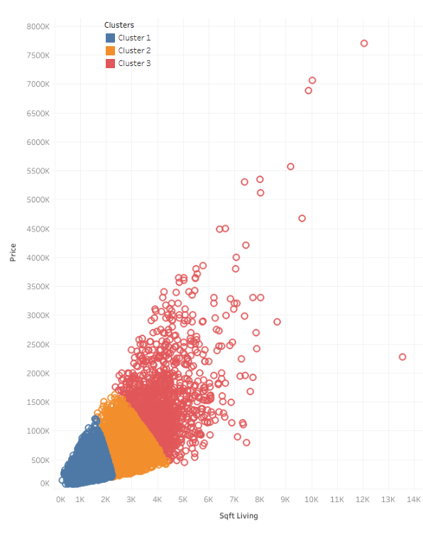
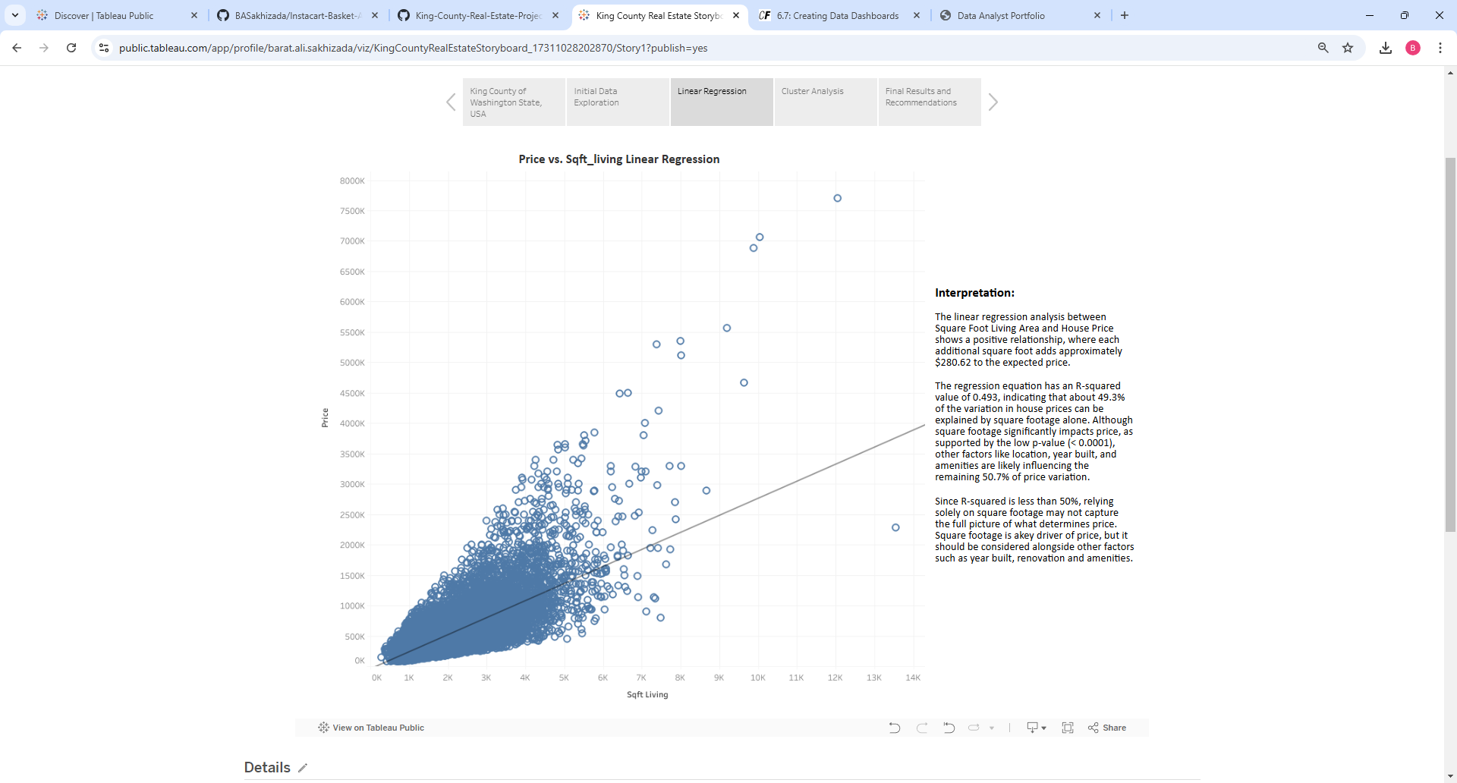
The linear regression analysis between Square Foot Living Area and House Price shows a positive relationship, where each additional square foot adds approximately $280.62 to the expected price. The regression equation has an R-squared value of 0.493, indicating that about 49.3% of the variation in house prices can be explained by square footage alone. Although square footage significantly impacts price, as supported by the low p-value (< 0.0001), other factors like location, year built, and amenities are likely influencing the remaining 50.7% of price variation.
Analysis
Cluster Analysis
Cluster 1 represents the most common type of home, with lower price and smaller living space, suitable for budget-conscious buyers. Average house price is around $378,570 and average sqft_living space is approximately 1,476 square.
Cluster 2 offers a middle ground with moderate pricing and larger space, catering to average families. Average house price is around $629,290 and average sqft_living space is approximately 2,654 sqft.
Cluster 3 represents high-value homes with spacious living areas, likely targeting affluent buyers. Average house price in this cluster is around $1,477,400 and average sqft_living space is approximately 4,241 sqft.
Simple Linear Regression Analysis

Slide 11
Key Takeaways
Majority of homes fall under $1 million, with few homes priced above $2 million. This indicates that the market is heavily concentrated around more affordable housing options, with luxury homes being a niche market.
Positive correlation between house price and square footage, indicating that larger homes tend to be more expensive. Living space is a key driver of home price.
No strong direct correlation exist between year built and price. This suggests that the age of the property does not directly impact its price, meaning other factors like location, view, or renovations may be more influential.
Buyers looking for affordable homes should prioritize properties similar to those in Cluster 1. These homes generally have smaller square footage and lower prices, making them suitable for first-time buyers or budget-conscious families.
Since the data shows that the price of a property is more influenced by square footage than the year it was built, buyers may benefit from focusing on larger homes even if they are older
Investing in renovations could enhance the property’s market value without the higher upfront costs of newer homes.
Since year of construction doesn’t heavily impact price, investing in larger, older properties with high renovation potential may yield high returns.

Slide 12
Retrospective
What Went Well
Data Cleaning: Effective handling of missing values and outliers ensured that the analysis was robust.
Visualization: Creating interactive dashboards in Tableau helped communicate findings clearly.
Clustering: Despite initial challenges, applying the elbow method led to meaningful segmentation of the housing market.
What Could Be Improved
Inclusion of Additional Variables: The model could have been improved by incorporating data on neighbourhood quality, proximity to amenities, and local economic indicators.
Surprises Encountered
The weak correlation between year built and house prices was unexpected, as newer homes are often assumed to have higher prices.
Identified Skill Gaps
Advanced Machine Learning: While linear regression and clustering were sufficient for this project, learning more advanced techniques would be beneficial for future projects.

Slide 13
CONTACT
BARAT ALI SAKHIZADA
basakhizada@gmail.com
Github Repository
https://github.com/BASakhizada

